Slide 1

Building and Testing Directives
Pete Bacon Darwin

Slide 2
The Three Pillars of AngularJS
Data Binding
Dependency Injection
Directives

Slide 3
Data Binding
Decouple application layers (MVC)
Digest-based dirty checking
Models are POJOs
DOM is updated “after” digest
Less Code – Easier to Test
More Maintainable!

Slide 4
Dependency Injection
Don’t worry about how dependencies are constructed
Mock out dependencies for fast, clean unit tests
No unnecessary boiler plate construction code
Less Code – Easier to Test
More Maintainable!

Slide 5
Directives
Decouple View from Business Logic
Extend the Browser
Declarative DSLs
Less Code – Easier to Test
More Maintainable!
<accordion>
<accordion-group heading=“Item 1”>
<p>Some content</p>
</accordion-group>
</accordion>

Slide 6
Blink Directive
Bringing back the Good Old Days!
<blink>
Mr Bean!
</blink>

Slide 7
Core Directives
<ng-repeat>, <ng-switch>
<ng-show>, <ng-hide>, <ng-class>
<ng-include>, <ng-view>
<input>, <select>, <form>
<a>, <script>
multiple, selected, checked,
disabled, readonly, required

Slide 8
Custom Directives
Angular UI (jQuery)
<ui-if>, <ui-date>, <ui-jq>, <ui-validate>
<ui-select2> , <ui-map>, <ui-keypress>
Angular UI (bootstrap)
<accordion>, <pagination>
<dropdown-toggle>, <tabs>, <modal>

Slide 9
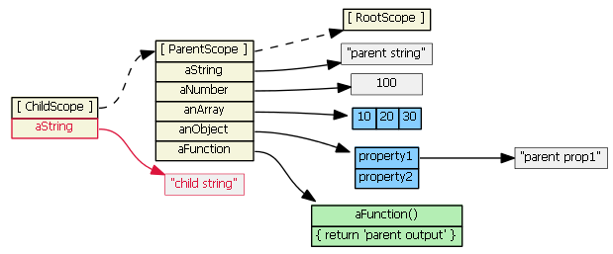
An Aside on Scopes
Scopes normally inherit prototypically
JavaScript “prototype” lookup
for “getting” a property

Slide 10
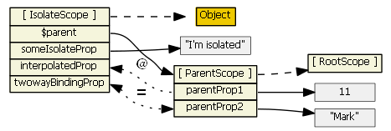
Isolated Scopes Do Not!
You can access the Parent Scope via $parent
Directives can bind attributes to Isolated Scope

Slide 11
Defining a Directive
Define directive on a module
Provide a name and a factory function
myModule.directive(‘directiveName’, function(deps) {
return {
// Directive Definition Object
};
}
);

Slide 12
The many names of …
A directive has one canonical name used in JavaScript:
In HTML it can take a number of different forms:
myDirective
my-directive
my:directive
my_directive
data-my-directive
X-my-directive
…

Slide 13
Directive Definition Object
restrict
compile & link
template, templateUrl, replace
scope & transclude
controller & require
terminal & priority

Slide 14
Restrict
Where can we place the directive?
An Element (E)
An Attribute (A)
A CSS Class (C)
A Comment (M)
All together!
<my-directive>
<div my-directive=“”>
<div class=“my-directive”>
<!-- directive: my-directive -->
restrict: ‘EACM’

Slide 15
Compilation Process – Compile
Traverse down the DOM from the compilation root node
Collect up all the directives for each node
Call each directive’s compile function
Compile functions contain common code,
manipulate the DOM
and return a link function
Notes:
Compiler access nodes through indexes.
Basically, you can change the DOM structure during compile:
- you can do anything you like with your children (add nodes, remove nodes, reorder, add/remove directives, whatever you want).
- you can do anything with siblings below you (those who were not compiled yet)
- you can't change siblings who are above you (those who were already compiled)
you can't change parents
So, example in child1 compile function, you can:
- do anything with the content (child1a, child1b)
append new nodes after child1
But you can't prepend nodes before child1!
In linking functions, you should not manipulate the structure, in general.
You can manipulate anything that has already been linked (eg. in post link, you can manipulate your children), however Angular won't notice that.
That might be actually desired sometimes - eg. if you are wrapping some jq ui component. You basically tell angular to ignore the whole content of your element and let jq plugin do all the stuff and you only communicate with it, but Angular does not bind inside the jq ui component.
If you need to manipulate the structure in link phase (or as a result of some watcher), you probably want to compile it on your own. That's for example something that ng-repeat does. It terminates the main compiler pass, so that content of ng-repeat is ignored - not compiled. It gets $compile injected and compiles the content on its own.

Slide 16
Compilation Process – Link
A Link Function is created for each DOM node
A suitable scope is attached to each node
The root node Link Function will call all the directive link functions – top down
Each link function is responsible for binding the element to the scope

Slide 17
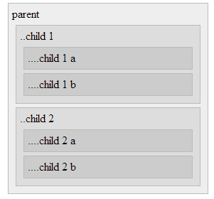
Example Compilation
parent (compile)
child 1 (compile)
child 1 a (compile)
child 1 b (compile)
child 2 (compile)
child 2 a (compile)
child 2 b (compile)
parent (controller)
parent (pre-link)
child 1 (controller)
child 1 (pre-link)
child 1 a (controller)
child 1 a (pre-link)
child 1 a (post-link)
child 1 b (controller)
child 1 b (pre-link)
child 1 b (post-link)
child 1 (post-link)
child 2 (controller)
child 2 (pre-link)
child 2 a (controller)
child 2 a (pre-link)
child 2 a (post-link)
child 2 b (controller)
child 2 b (pre-link)
child 2 b (post-link)
child 2 (post-link)
parent (post-link)

Slide 18
Compile Function
The compile function is passed
The current template element (jQLite wrapped)
A normalized list of element’s attributes
A transclusion function, if applicable
It should return the post link function
compile: function(element, attrs, transcludeFn) {
return someLinkFn;
}

Slide 19
Post Link Function
The post link function is passed
The current scope
The compiled element (jQLite wrapped)
A normalized list of element’s attributes
A directive controller, if applicable
link: function(scope, element, attrs, cntlr) {
scope.$watch(.);
attrs.$observe(.);
element.bind(.);
}

Slide 20
Templated Directives
Directives can provide a HTML template
The compiler will compile the template and replace content of the directive’s DOM element.
If replace: true then the directive’s DOM element replaced entirely by the template.
template: ‘<div>Some {{angular}} html</div>’
or
templateUrl: ‘some/url/to/the/template’

Slide 21
Child Scope
By default directives simply use the scope provided by the parent DOM element
A new child scope can be attached to the current DOM element by
This new scope will prototypically inherit from the parent scope
scope: true

Slide 22
Isolated Scope
A new Isolated Scope can be created by:
This scope does not inherit from its parent, but is related by $parent.
Only really needed if you are providing a template
We need a way to get values from the parent scope into this one…
scope: { . }

Slide 23
Binding to Isolated Scope
We can manually bind values in the Isolated Scope to values in the Parent Scope using the directive “scope object”
key: isolated scope property
value: binding type and attribute name
There are three types of binding
Two Way Data Binding (=)
Interpolated Strings (@)
Executable Expressions (&)

Slide 24
Two Way Data Binding (=)
The = binding creates watches that ensure that the value in the Parent Scope and the value in the Isolated Scope are kept in synch
Parent Scope user.name will mirror Isolated Scope innerName
<my-directive attr-name=“user.name”>
scope: { innerName: ‘=attrName’ }

Slide 25
String Interpolation (@)
The @ binding will watch the attribute value, and provide the interpolated string to the Isolated Scope property whenever it changes.
This is one way and generates a string.
If Parent Scope user.name is “Pete”, then the Isolated Scope innerGreeting will be “Hello Pete!”
<my-directive attr-greeting=“Hello {{user.name}}!”>
scope: { innerGreeting: ‘@attrGreeting’ }

Slide 26
Executable Expression (&)
The & binding will create a function that is attached to the Isolated Scope, which when called will execute the expression provided in the attribute.
If onClose() is called on the IsolatedScope, then log(‘closed’) will be called on the Parent Scope.
This is one way from Isolated Scope to Parent Scope.
<my-directive close-handler=“log(‘closed’)”>
scope: { onClose: ‘@closeHandler’ }

Slide 27
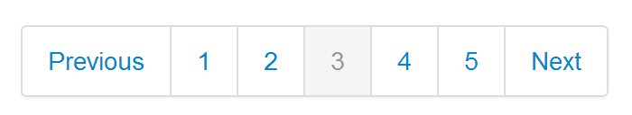
Pagination Directive
Bootstrap styled pagination directive
Uses templates, isolated scope, bindings
<pagination
num-pages="numPages"
current-page="currentPage"
on-select-page="selectCount=selectCount+1">
</pagination>

Slide 28
Transclusion
If we want to use the original content of the DOM element that is replaced by the template, we use transclusion.
We can transclude the contents of the current element
Or the whole element itself
transclude: true
transclude: ‘element’

Slide 29
Transclusion - The Easy Way
Most of the time you can simply use the ng-transclude directive in your templates
The contents of the ng-transclude element will be replaced with the transcluded content.
<div>
Some template stuff
<div ng-transclude>to be replaced</div>
</div>

Slide 30
Using Transcluded Content
The transcluded content is made available as a transclusion linking function.
This function returns an element containing the transcluded content, bound to the given scope.
The function is passed to the compile function.
var element = transcludeFn(scope);

Slide 31
Cloning Transcluded Content
Some directives actually want to clone the transcluded content rather than use the original. (e.g. ng-repeat)
By providing a callback it will clone the content. Use the callback to attach the clone to the DOM.
var clone = transcludeFn(scope,
function cloneAttachFn(clone, scope){
.
});

Slide 32
Directive Controllers
Directives can define a controller function to be attached to the DOM node.
Can be dependency injected
$element, $attrs, $transclude
controller: function($scope, $element, $attrs, $transclude, otherDeps) {
$scope.$watch(.);
$attrs.$observe(.);
$element.bind(.);
this.someControllerMethod = function(){.};
}

Slide 33
Requiring Controllers
Directives can require other directives’ controllers be available
On the current node
On an ancestor node
Optional
More than one
These are passed to the link function (as the fourth parameter, controller)
require: ‘ngModel’
require: ‘^form’
require: ‘?myDirective’
require: [‘?directive1’,
‘^directive2’]

Slide 34
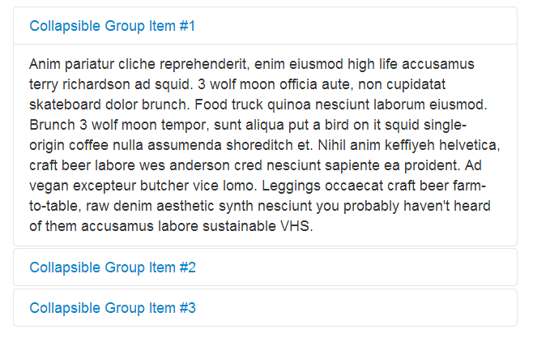
Accordion Directive
A Multi-directive widget
Uses directive controllers & transclusion
<accordion >
<accordion-group>
</accordion-group>
</accordion>

